Slide 1
National Assessment Resource
NAR Familiarisation with a specific focus on Modern Languages Materials
Notes:
HOW TO USE THIS RESOURCE
How this resource is used will vary according to the needs of the individual / group and can be over more than one session.
The resource may be used INDIVIDUALLY in order to familiarise the practitioner with specific areas of NAR.
It can also be used COLLECTIVELY with the aim of stimulating professional dialogue and reflection, for example for the purpose of moderation with departmental or whole school staff, subject networks, engaging with partners, etc…
The PowerPoint Presentation can be accessed on a stop/start basis from beginning to end as and when time permits.
Alternatively, practitioners may wish to directly access sections which have specific relevance to their individual or collective needs at a particular time.
The PowerPoint Presentation should ONLY be used / viewed in conjunction with the notes on the slide notes pages.
(It would be useful to have a paper copy of notes pages to hand when using this PowerPoint Presentation)

Slide 2
Aims
To further develop our understanding of NAR
To consider how we might use NAR to support learning, teaching and assessment
To explore NAR and consider the story so far in populating it
Notes:
AIMS :
To further develop our understanding of NAR
To consider how we might use NAR to support learning, teaching and assessment
To explore NAR and consider the story so far in populating it

Slide 3
Outcomes
More familiar with available guidance and more confident in accessing appropriate resources from NAR .
Better understanding of how NAR supports learning, teaching and assessment.
Better understanding of how NAR supports moderation activity.
Notes:
BY THE END OF THIS SESSION(S) , it is hoped you ...
Have a better understanding of how NAR supports learning, teaching and assessment / moderation.
Are more familiar with available guidance and more confident in accessing appropriate resources from NAR .
Have a better understanding of how NAR supports moderation.

Slide 4
What is NAR?

Slide 5
What is NAR?
Introduced 2008 as joint venture between Learning and Teaching Scotland (LTS, now Education Scotland), Scottish Qualifications Authority (SQA) and Scottish Government.
Online resource providing examples of assessment approaches (aged 3-15) developed by Education Scotland, SQA and practitioners.
Assessment exemplars moderated at school, local authority or cluster level then quality assured at national level.
Notes:
NAR - Scotland’s National Assessment Resource - is an online resource designed to support assessment approaches for Curriculum for Excellence.
NAR will support practitioners in developing a shared understanding of standards and expectations for Curriculum for Excellence and how to apply these consistently.

Slide 6
Supporting Assessment
in Practice
Acknowledgement to
Education Scotland
Notes:
NAR OVERVIEW VIDEO- Acknowledgement to Education Scotland.
Click on coloured bar to access video.

Slide 7
What are the aims of NAR?

Slide 8
NAR – Key Aims
To support teachers and practitioners in:
deepening their understanding and expertise in assessment.
developing a shared understanding of standards and expectations.
developing their capacity to make sound judgements about progress and achievement.
Notes:
NAR has many purposes.
The key purposes are to :
increase practitioners’ understanding of expectations and standards for Curriculum for Excellence.
increase their understanding of learning intentions in order to support more creative teaching approaches in schools.
support practitioners to understand how breadth, challenge and application are inter-related aspects of learning, not separate features.
develop their capacity to make sound judgements about progress and achievement.

Slide 9
Notes:
The main functions of NAR are spelled out in BtC 5, a framework for assessment (p41)
“One of the key functions of the National Assessment Resource is to provide a way for teachers to develop a shared understanding of standards and expectations. The Resource will support teachers in deepening their understanding and expertise in assessment.
It will also help develop their capacity to make sound judgements about progress and achievement.”

Slide 10
Using NAR to understand Assessment and support Moderation
Notes:
How can NAR help us better understand assessment and support MODERATION?

Slide 11
Acknowledgement to
Education Scotland
Notes:
How can NAR help?
Helpful publication sets out different ways in which NAR supports assessment and moderation.
http://about.narscotland.org.uk/Images/UsingNARforAssessment_tcm4-662726.pdf
UNDERSTAND APPROACHES TO ASSESSMENT:
How you can develop your thinking and practice of assessment in the context of Curriculum for Excellence.
How you can build on the emerging practice and examples provided on NAR to help you extend your range of assessment approaches.
How you can use the assessment exemplars and materials to provide a focus for reflection and professional dialogue.
How you can use the exemplars to develop a shared understanding of standards and expectations which can be applied fairly and consistently.
How you can use NAR as a forum to share your comments and ideas.
SHARE MATERIALS WITH OTHERS: Upload and publish the assessments you have created for others to find, use and adapt.
• Classify your materials in terms of Curriculum for Excellence level/s, curriculum area/s and experiences and outcomes to help others find them.
• Describe your materials to provide information and context to other NAR users

Slide 12
Using NAR to Understand Assessment
Acknowledgement to
Education Scotland
Notes:
Click on COLOURED BAR to access video: Using NAR to understand Assessment (Acknowledgement to Education Scotland)
In this film clip, through the assessment exemplars , practitioners share insights into assessment in practice in real classrooms and assessment as a coherent part of the L and T process.

Slide 13
Acknowledgement to
Education Scotland
Notes:
NAR enables educators to:
UNDERSTAND : develop their thinking and practice of assessment within the context of CfE
PLAN: see how colleagues have planned from the Es and Os – enabling others to reflect on and develop their own planning
CREATE: create , copy ,amend or customize materials to meet the needs of their learners
MODERATE : use exemplars as a focus for discussion to raise standards and expectations and to ensure consistency
SHARE : share, upload and publish materials for others to find, adapt and use
USE : use the available materials to support them in turning the Es and Os into action

Slide 14
How can I use NAR assessment exemplars?
to provide support for individual teachers to develop the process of linking curriculum, learning, teaching and assessment alongside reflection on classroom practice
to generate discussion on emerging standards and expectations and establish local moderation procedures in schools and centres, within departments, faculties, cluster school groups, and in local authorities
Notes:
HOW CAN I USE NAR ASSESSMENT EXEMPLARS?
Teachers taking part in this collaborative approach are actively involved in the process of moderation. Moderation involves reflection and dialogue about
learning.
Practitioners can use NAR materials as a focus for moderation activities. When uploading materials, practitioners will be expected to specify whether moderation has taken place at peer, school, cluster or local authority level.
Local authorities can make individual arrangements for moderation at authority level and can also put forward exemplars created by practitioners for national quality assurance and moderation.

Slide 15
Click on chart for interactive video
Acknowledgement to Education Scotland
Notes:
CLICK ON CHART FOR INTERACTIVE SLIDE
Step by step instructions can be found on the National Assessment Resource homepage—entitled NAR Process: http://about.narscotland.org.uk/Images/NAR-Flow-chart_tcm4-671023.pdf (Acknowledgement to Education Scotland)
PLAN TO ENSURE THAT assessment is part of the T and L process: Use NAR exemplars to see how practitioners have developed learning using the experiences and outcomes and created learning intentions and success criteria.
• Explore each element of the planning process demonstrated in the exemplars.
• Reflect on the learning experiences described in the exemplars and consider their relevance to your own practice.
• See how the practitioners have provided opportunities for ongoing assessment. This includes peer and self-assessment, the delivery of quality feedback and next steps in learning.
• See how practitioners have agreed the standards and expectations of learning.
• Use this process as a model to develop thinking about your planning, or take any of the elements of the planning process as a focus for development and improvement

Slide 16
Use of NAR in Local Authorities
Local authority staff seconded as mentors to support and engage with practitioners on NAR.
Development of assessment materials by practitioners to increase their understanding of moderation and range of evidence.
Establishment of cluster assessment groups to allow sharing of practice and discussion of assessment issues.
Notes:
USE OF NAR in LAs:
Increasing practitioner awareness of link between learning within experiences and outcomes, how they could be interpreted and assessed in their schools.
Increasing understanding of assessment as integral part of learning and teaching process.
Practitioner involvement in dialogue and collaboration is supporting establishment of learning communities at school and cluster level.

Slide 17
How did working through the NAR process impact on practitioners’ thinking about assessment practice?
Acknowledgement to Education Scotland
Notes:
Click on coloured bar for VIDEO: (Acknowledgement to Education Scotland)
This video gives us an insight into how working through the NAR process has impacted on how practitioners think about assessment.

Slide 18
Use of NAR at national level
Practitioner involvement from initiation of NAR and collaboration is increasing professional capacity and expertise in assessment across Scotland.
Increasing awareness of the link between curriculum, assessment and progression across Scotland.
Supporting move away from linear model of learning.
Local authority involvement is supporting development of learning communities across authorities.
Notes:
USE OF NAR at NATIONAL LEVEL:
Moderation involves reflection and dialogue about learning.
Practitioners can use NAR materials as a focus for moderation activities. When uploading materials, practitioners will be expected to specify whether moderation has taken place at peer, school, cluster or local authority level.
Local authorities can make individual arrangements for moderation at authority level and can also put forward exemplars created by practitioners for national quality assurance and moderation.

Slide 19
Notes:
Education Scotland CfE Website: ASSESSMENT AREA: NAR: Access resource to find out how a variety of schools from numerous LAs are using NAR.
http://www.educationscotland.gov.uk/sharingpractice/h/howschoolsusenar/introduction.asp?strReferringChannel=learningteachingandassessment&strReferringPageID=tcm:4-614875-64&class=l3+d137987

Slide 20
Moderation Activity
In pairs, select an exemplar.
Is there appropriate challenge within the learning?
Consider the standards and expectations that have been set for the learners. Are they appropriate?
Is planning for progression evident?
Discuss the quality of the evidence gathered in relation to the success criteria. Does the evidence demonstrate achievement of the success criteria?
What has been done well?
What would you do differently to improve this exemplar?
Notes:
This is an example of a variety of different Moderation Activities which are being used by some schools.

Slide 21
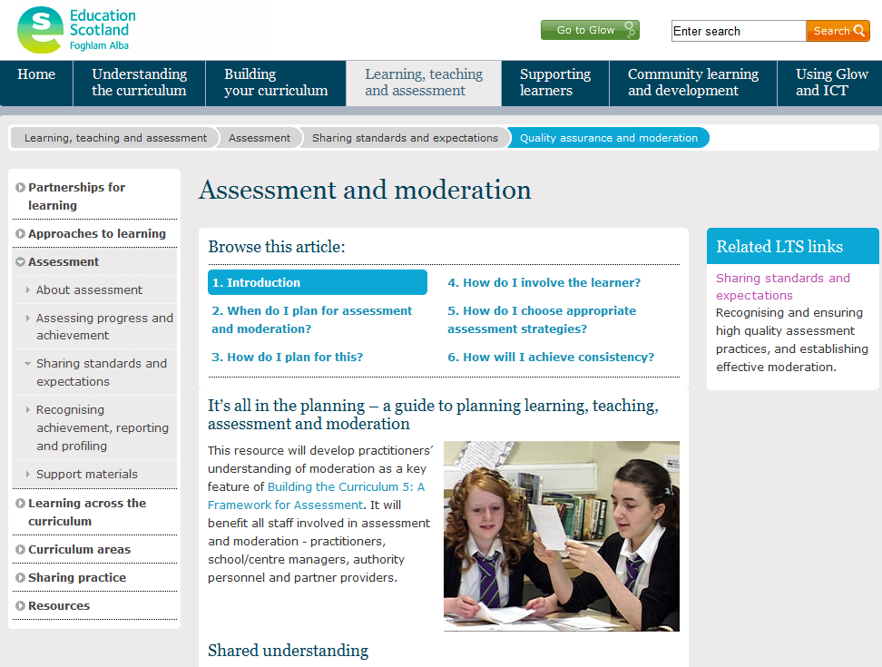
Notes:
Education Scotland CfE Website: ASSESSMENT AREA: Access “ASSESSMENT and MODERATION” resource.
http://www.educationscotland.gov.uk/resources/a/assessmentmoderation/introduction.asp?strReferringChannel=learningteachingandassessment&strReferringPageID=tcm:4-614875-64&class=l3+d141406
This resource will develop practitioners’ understanding of moderation as a key feature of Building the Curriculum 5: A Framework for Assessment. It will benefit all staff involved in assessment and moderation - practitioners, school/centre managers, authority personnel and partner providers.

Slide 22
What are the functions of NAR?
Notes:
What are the functions of NAR?
Depending on how you access NAR (as described previously), you may be able to do
some or all of the following.
Details on how to do all of these are made explicit in the NAR USER MANUAL
Available on NAR:
http://about.narscotland.org.uk/Images/NARUserManual_tcm4-671022.pdf

Slide 23
What are the functions of NAR?
Find resources:
Create and save searches / Browse the NAR library.
Use resources:
Preview resources / Add resources to a list of favourites or the basket /Download resources / View resource details / Add a comment / Add a label / Note a problem / Copy and adapt resources.
Create a resource:
Upload a resource / Create a question / Build an assessment / Describe a resource (add metadata)
Link related resources
Publish a resource (in the NAR library) to share with colleagues
Notes:
Depending on how you access NAR (as described above), you may be able to do
some or all of the following:
• Find resources:
o Create and save searches
o Browse the NAR library.
• Use resources:
o Preview resources
o Add resources to a list of favourites or the basket
o Download resources
o View resource details
o Add a comment
o Add a label
o Note a problem
o Copy and adapt resources.
• Create a resource:
o Upload a resource
o Create a question
o Build an assessment.
o Describe a resource (add metadata)
• Link related resources
• Publish a resource (in the NAR library) to share with colleagues
Details on how to do all of these are made explicit in the NAR USER MANUAL: Available on NAR:
http://about.narscotland.org.uk/Images/NARUserManual_tcm4-671022.pdf

Slide 24
User friendly guidance about NAR
Notes:
NAR USER MANUAL : http://about.narscotland.org.uk/Images/NARUserManual_tcm4-671022.pdf
Purpose of this guide
This guide describes how educators can use NAR to find, create and upload resources. It also describes how educators can collaborate with others by adding to and commenting on resources in NAR
TERMINOLOGY EXPLAINED
Describing a resource
By describing a resource, you provide specific information (metadata) that enables
other users of NAR to search for and find it.
NAR uses an agreed format for learning object metadata (LOM).
Publishing a resource
When you publish a resource, it becomes available to other users of NAR, within the
collection you selected when creating the resource.
(When you first create a resource, it is unpublished and therefore available only to
you.)
Other sources of help
The following guides may also be useful to you:
• National Assessment Resource (NAR): Guide for educators
http://about.narscotland.org.uk/Images/UsingNARforAssessment_tcm4-662726.pdf
• National Assessment Resource (NAR): Frequently asked questions.
Within NAR, you can refer to the online help: in the top-right menu, click Help.
Further specific online help is available for the Build assessment function through its
Help button.

Slide 25
Accessing and finding materials on NAR
Notes:
This section focuses on accessing and finding materials on NAR.

Slide 26
Notes:
So logging into NAR is fairly straight forward.
There are three options :
Google National Assessment Resource, enter through Glow or type www.narscotland.org.uk into the address bar.
When you reach this login page simple click the top, green option and login using your GLOW username and password.
Logging in to NAR
Different groups of users access NAR in different ways.
• Educators:
o Local authority partnership nurseries, and local authority schools and
colleges: via Glow
o Independent schools and colleges: via SQA Connect. (For information
about obtaining an SQA Connect login and password, go to www.sqaconnect.org.uk)
• SQA appointees: via the Appointee Portal. (SQA will send each appointee a
login and password.)
The route by which you access NAR determines which functions are available to you.

Slide 27
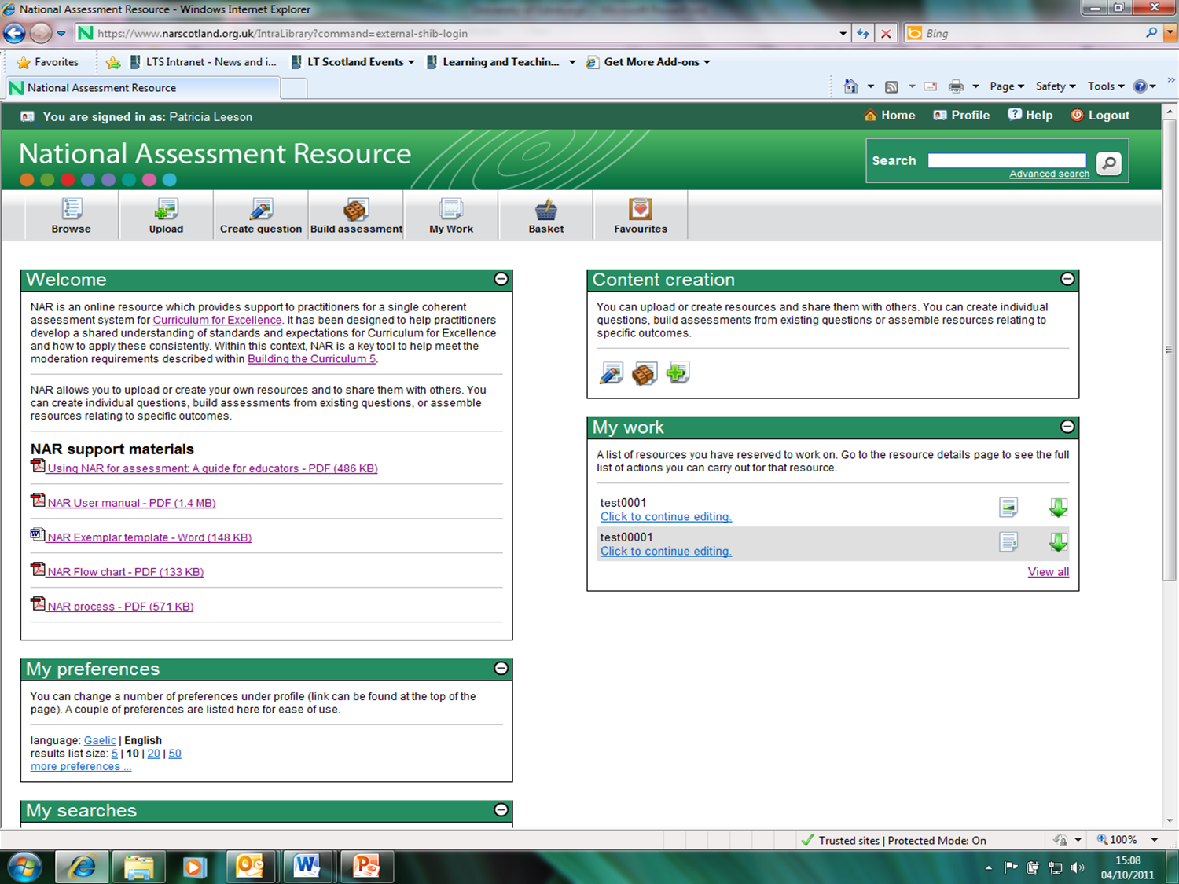
Notes:
So that people using NAR can easily find the resources they want, contributors are
encouraged to name their resources and describe them consistently.
Contributors who publish resources in the NAR library are encouraged to name their resources using a common vocabulary.
Also, when contributors describe their new resources, the information (metadata) they must provide conforms to an agreed standard for learning object metadata

Slide 28
Finding Materials on NAR
Acknowledgement to Education Scotland
Notes:
Click on the coloured bar for Video: Finding Materials on NAR
(Acknowledgement to education Scotland)

Slide 29
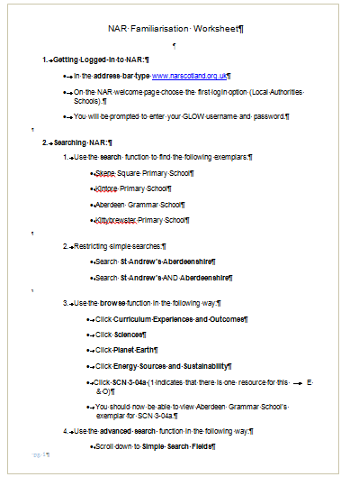
Acknowledgement to Education Scotland
Notes:
This is an example of the NAR FAMILIARISATION worksheets
(Acknowledgement to Education Scotland)

Slide 30
Using NAR to upload and create materials
Acknowledgement to Education Scotland
Notes:
Click on the coloured bar for Video: Using NAR Upload and Create Materials
(Acknowledgement to Education Scotland)

Slide 31
Populating NAR: the story so far…
Notes:
This section updates practitioners on the different phases taken for populating NAR

Slide 32
Populating NAR: the story so far…
NAR (Phase 1) Responsibility of All
NAR (Phase 2) Curriculum
NAR (Phase 3a) Recognising Achievement, Profiling, and Reporting
NAR (Phase 3b) Consistent assessment approaches for larger groups of learners
Notes:
Practitioners involved in PHASE 1 of developing materials for NAR were encouraged to focus on the Responsibility of All (RoA) areas of the curriculum i.e. LITERACY / NUMERACY / HWB
They were asked to choose one or two Es and Os of their choice from the RoA areas as well as a coherent E and O from the curriculum area of their choice
Practitioners involved in PHASE 2 of developing materials for NAR were encouraged to focus on a specific curriculum area
They were asked to choose one or two Es and Os from their specific curriculum area as well as a coherent E and O from one of the Responsibility for All areas
Practitioners involved in PHASE 3a of developing materials for NAR were encouraged to focus on either RECOGNISING ACHIEVEMENT, PROFILING or REPORTING within a specific curriculum area
Practitioners involved in PHASE 3b of developing materials for NAR were encouraged to focus on consistent assessment approaches for larger groups of learners within a specific curriculum area

Slide 33
NAR (1) Responsibility of All
3rd Level:
Health and wellbeing / Modern Languages
St. Peter the Apostle HS
2nd Level:
Literacy / Modern Languages
Port of Menteith PS
2nd Level:
Literacy / Modern Languages
Andersons PS
Notes:
NAR PHASE 1 : Exemplars which have a particular Modern Languages focus
2nd LEVEL Port of Menteith PS https://www.narscotland.org.uk/virtual_file_path/991/20110729094216/index.html
Experiences and Outcomes
LIT 2-09a
When listening and talking with others for different purposes I can share information, experiences and opinions.
MLAN 2-02a
I explore how gesture, expression and emphasis are used to help understanding.
Background and context
Learners were fully engaged by a practical activity which supported them to develop their knowledge, understanding and skills
in modern language and challenged them to apply this learning in a realistic simulation. As they developed their modern language skills, they were afforded a range of opportunities for developing their literacy skills.
2nd LEVEL Andersons PS
https://www.narscotland.org.uk/virtual_file_path/43/20110627162152/index.html
Experiences and Outcomes
LIT 2-02a: When I engage with others, I can respond in ways appropriate to my role, show that I value others’ contributions and use these to build on thinking
MLAN 2-06a: I can deliver a brief presentation on a familiar topic using familiar languages and phrases
Background and context
Children worked collaboratively on four separate projects to help them to learn greetings and facts about families and pets in French. They are engaged in these tasks and make good use of ICT. The exercises include discussions on success criteria and culminate in a group presentation to the class.
QUALITY MARKED: 3rd Level St Peter the Apostle (HWB and MLs)
https://www.narscotland.org.uk/virtual_file_path/991/20110729094216/index.html
Experiences and Outcomes:
HWB 3-11a: I can help to encourage learning and confidence in others.
MLAN 3-06a: I have contributed successfully to a group to plan and prepare short talks in the language I am learning.
Background and context
Quality mark for Health and wellbeing across learning. T his exemplar shows pupils working together to create their own speaking tests in French. As they do so they are supported and challenged to work as teams the members of which should help each other when appropriate, listen to each other and encourage learning and confidence in others.

Slide 34
NAR 2 - Curriculum
MODERN LANGUAGES:
2nd Level: French
Gavinburn PS
Mid Calder PS
3rd Level : French
KINGUSSIE HS
3rd Level : German
Stromness High
4th Level: French
DOUGLAS ACADEMY
4th Level : French
Balerno HS
Notes:
NAR PHASE 2 : Focus on CURRICULUM AREA
GAVINBURN PS: FRENCH/HWB -2nd Level - Pupils work together to use their knowledge of French vocabulary and pronunciation in order to participate in creating a prepared talk. P5 and 6 create podcasts and P7 prepare an interview.
MID CALDER PS: FRENCH-2nd Level- P6 and P7 projects illustrate how writing in a foreign language is developed in combination with the other language skills and specifically those of reading and speaking.
KINGUSSIE: FRENCH/LIT- 3rd Level- S2 learners handle reading of more complex texts in French which are relevant to the modern world and show sophistication in information handling to progress literacy skills.
BALERNO : FRENCH/LIT -4th Level- improve the confidence of S2 and S3 learners when writing in French and to ensure that learners no longer rely solely on memorised material
DOUGLAS ACADEMY: FRENCH / LIT 4th Level- S2 learners are asked to examine such things as plot, key scenes, word choice and character in a French text prepared in the department whilst S3 learners are asked to examine the more complex features of a French literary text, the Prévert poem ‘Déjeuner du Matin’.
STROMNESS: GERMAN / LIT – 3rd Level- S2 learners compare and discuss healthy and unhealthy lifestyles in German

Slide 35
NAR 3a
Recognising, achievement, profiling and reporting
Lesmahagow High
Notes:
NAR PHASE 3a : Focus RECOGNISING ACHIEVEMENT / PROFILING / REPORTING within a curriculum area.
Lesmahagow High pupils are encouraged to recognise and keep a log of their achievements and developments in learning and skills both within and out with school and to use this information to write reflectively about what they have accomplished.

Slide 36
NAR 3B
Consistent Assessment Approaches for Larger Groups of Learners
Notes:
NAR PHASE 3b: Focus on consistent assessment approaches for larger groups of learners

Slide 37
Innovation Fund
Quality Assurance and Moderation Exemplars
Notes:
MODERATION across 6 LAs – focus area is MODERATION in context of GAELIC
In this exemplar Argyll and Bute, Western Isles, South Lanarkshire, North Lanarkshire, Edinburgh and Highland councils collaborated to develop standards of moderation of Gaelic medium writing experiences and outcomes. The schools included Tollcross Primary School; Portree Primary School; Iochdar Primary School; Condorrat Primary School; Greenfaulds Primary School and others.
https://www.narscotland.org.uk/_search.jsp?search_phrase=SOUTH%20LANARKSHIRE

Slide 38
Notes:
“Ultimately as confidence and understanding grows, teachers will have more ownership of the National Assessment Resource”.
BtC5: a framework for assessment (p41)
The potential of NAR can be truly fulfilled by practitioners using it together to achieve success.
By sharing your materials with others, and using NAR as a tool to support your
practice, we can make a positive impact on the learning experiences and outcomes for Scotland’s young people

Slide 39
Evaluation: how well have we met the agreed learning outcomes?
Notes:
If, on the basis of accessing this resource / self-evaluation, there are issues you wish to raise, comments you wish to make on the usefulness of this resource or any suggestions for improvement, you should take the opportunity to get in touch by forwarding staff at SCILT an email: scilt@strath.ac.uk

Slide 40
Outcomes of session
More familiar with available guidance and more confident in accessing appropriate resources from NAR .
Better understanding of how NAR supports learning, teaching and assessment.
Better understanding of how NAR supports moderation activity.
Notes:
BY THE END OF THIS SESSION , it is hoped you ...
Have a better understanding of how NAR supports learning, teaching and assessment / moderation.
Are more familiar with available guidance and more confident in accessing appropriate resources from NAR .
Have a better understanding of how NAR supports moderation.

