Slide 1

Reading Module 1 (RM1)
Resource 2

Slide 2

Reading
This module will explore:
What we read and why
Different types of text and how to exploit them
Reading strategies to support students’ learning

Slide 3
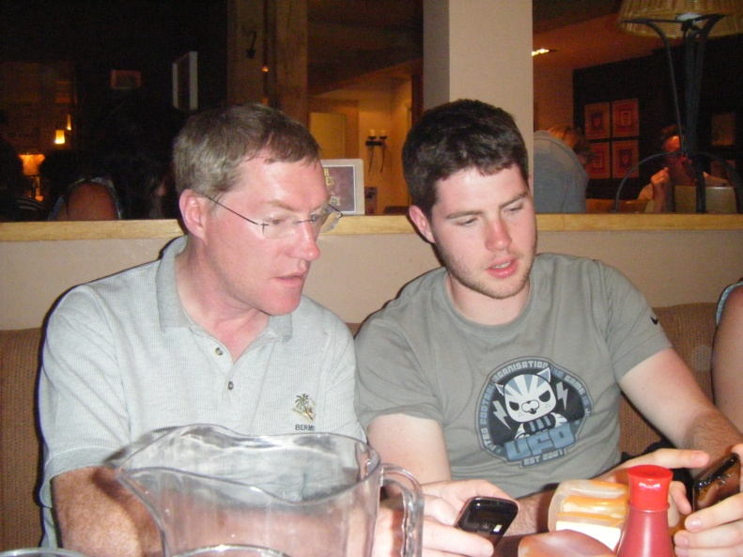
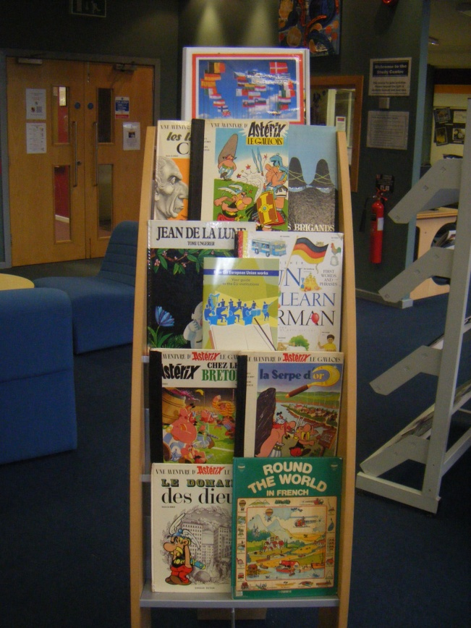
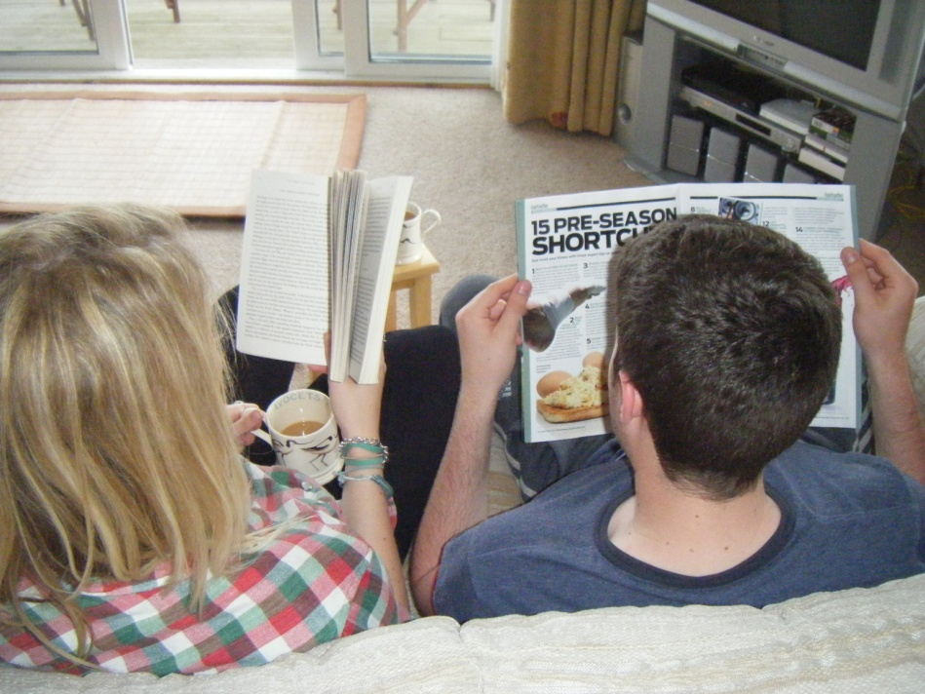
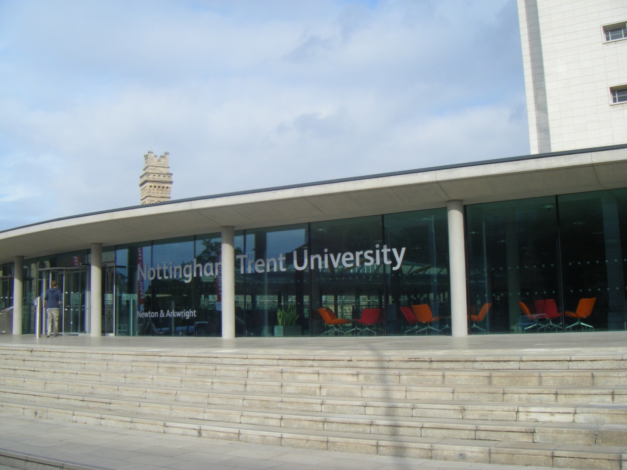

Why do we read?
Why do our students read?
...for information
...for pleasure
...to encounter
new language and cultural information
...for exam success
...for gist or detail

Slide 4

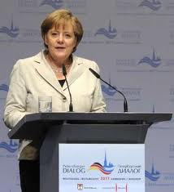
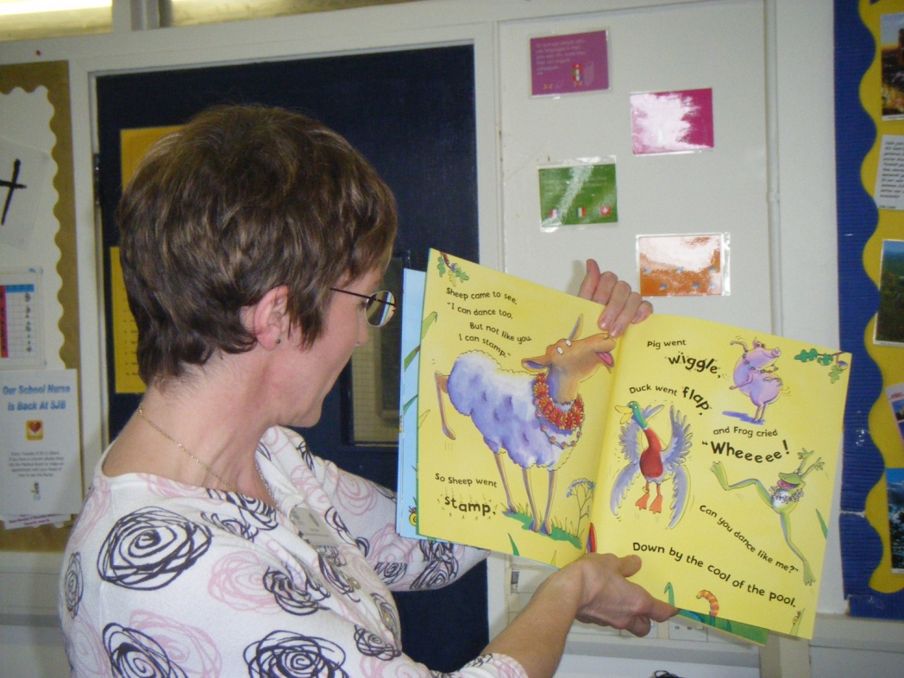
Reading Aloud
Reading or Speaking?
Reading the news
Making a speech
Reading stories

Slide 5
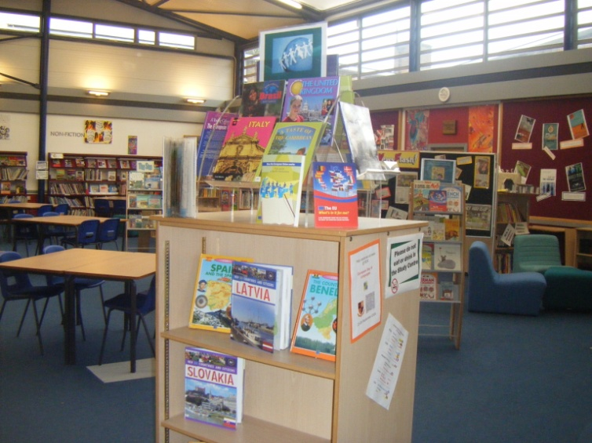
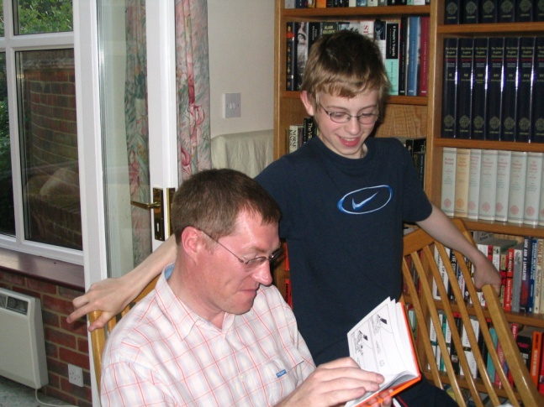


Reading is caught not taught
...at school?
How?
...at home?
...amongst friends?

Slide 6
Poetry and Song
Inspire imagination and creativity
Give cultural insights
Music and rhythm aid memory
Rhyme reinforces grapheme-phoneme link
Grammar and vocabulary can be
exploited in context

Slide 7
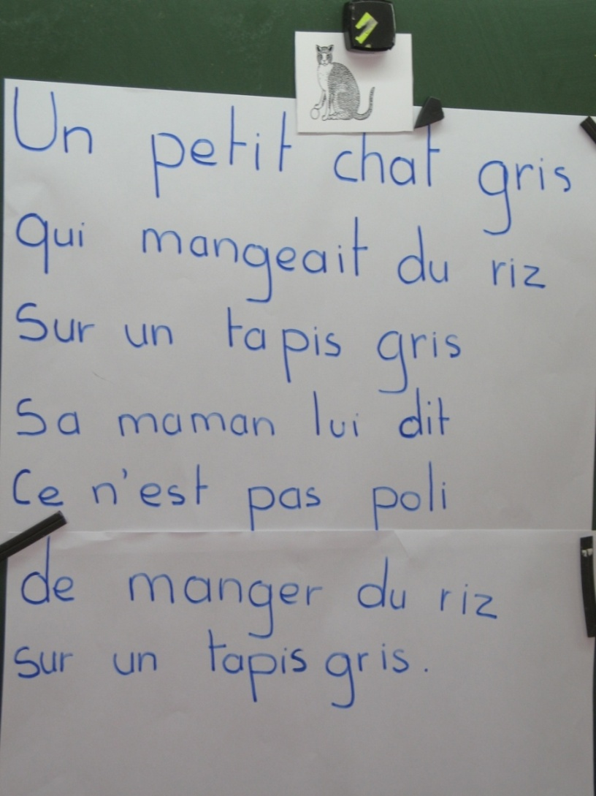
Using Poetry and Song

Slide 8


Slide 9
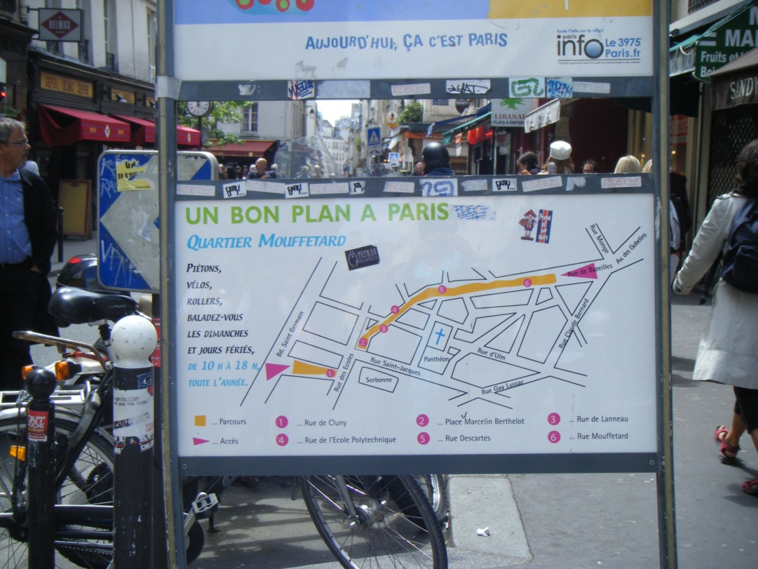

Slide 10
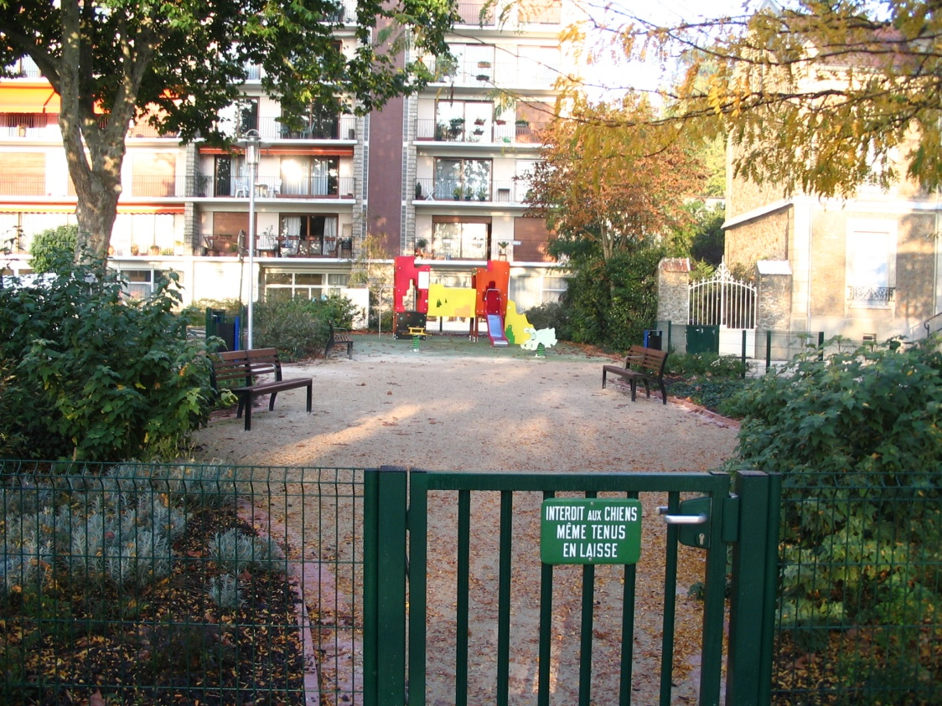

Slide 11
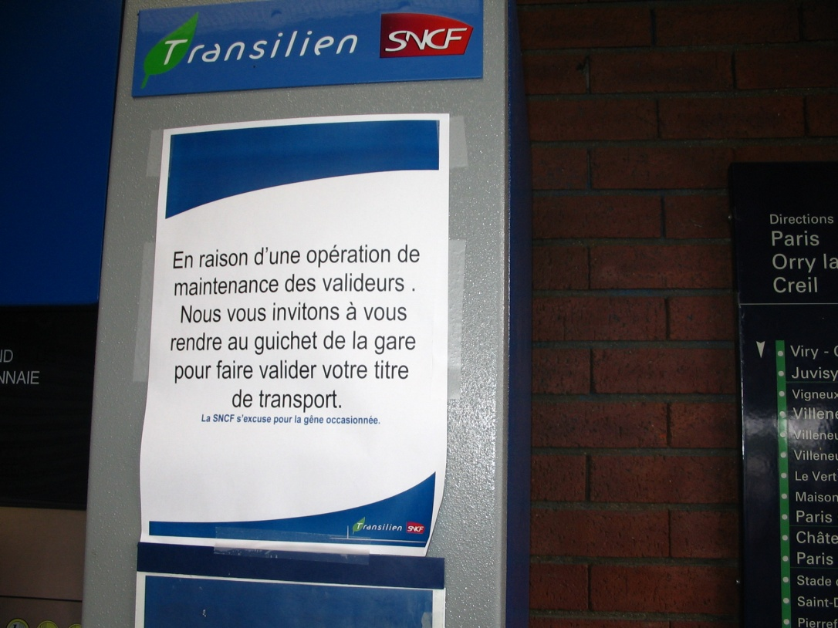

Slide 12


Slide 13
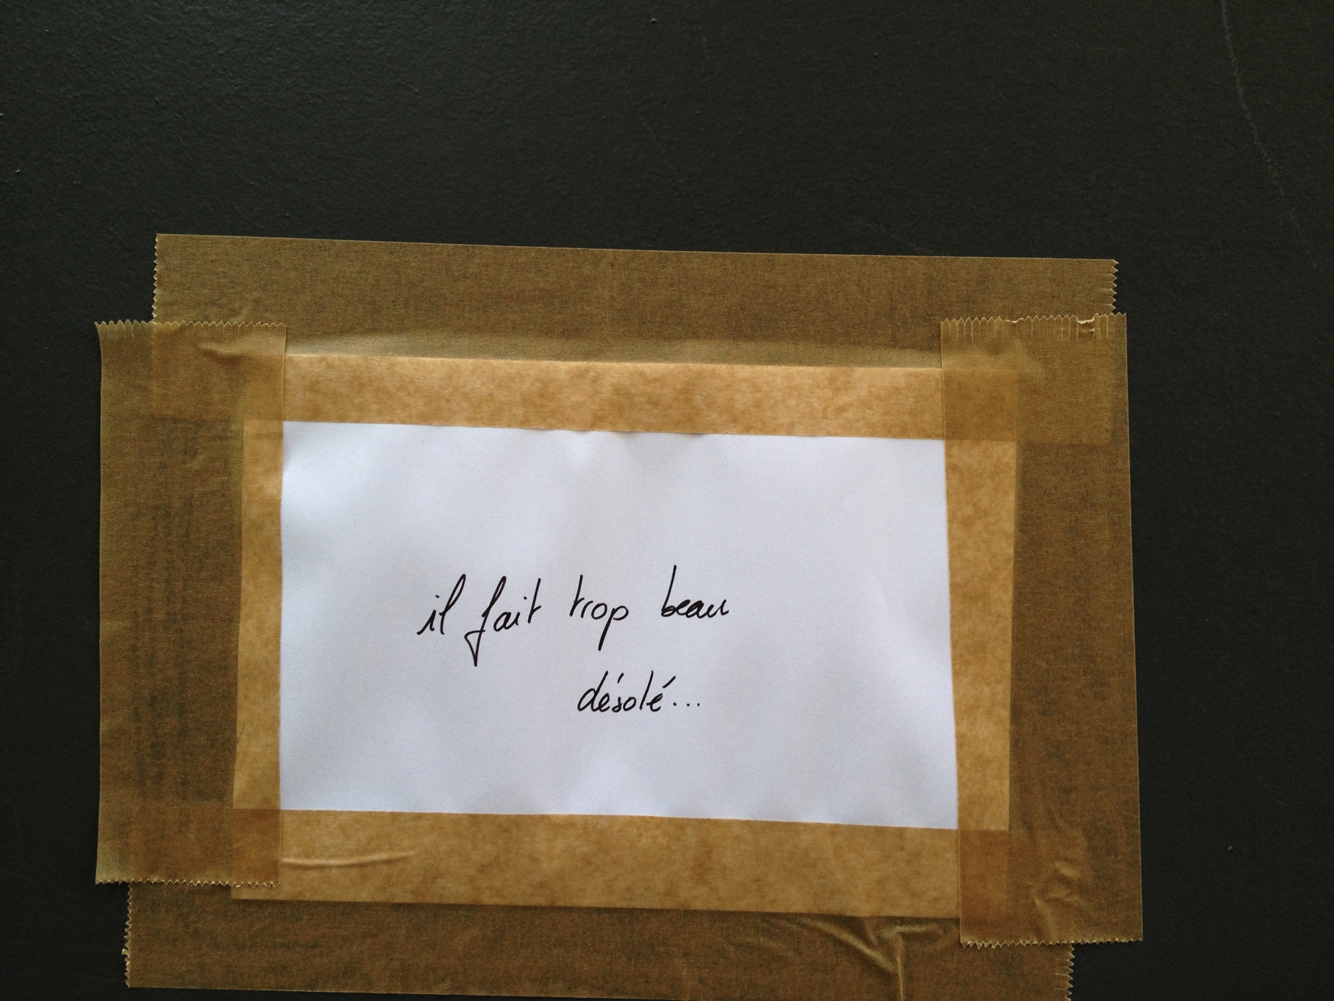

Slide 14

Using non-fiction texts
La temperatura media en 2010 es una de las más altas de los últimos
20 años
En el año 2010, la temperatura media del planeta igualó las más calientes jamás registradas, es decir las de 2005 y 1998. Esto confirma una vez más que el calentamiento global es una realidad y no podemos descartar la posibilidad de que aumente el número de desastres naturales y que estos desastres sean más intensos y más frecuentes .
La Organización Meteorológica Mundial (OMM)
reveló hoy estos datos, y confirmó que la
temperatura global el año pasado fue 0,53 grados
centígrados más alta que la de 1961 – 1990,el
periodo de referencia adoptado por la institución
científica.

Slide 15
Reading Strategies
Pictures
Title
Context
Cognates
Previous knowledge
Dates & Names
Predictions

Slide 16
Motivating reading tasks
Racing Dictation
‘Guess who’ information about teachers
Treasure hunts
Games with instructions on bits of paper (which must be
read secretly)
Tasks requiring reflection and a personal response
Puzzle solving
Subject matter that taps into individual students’ interests/skills

Slide 17
Further reading
  National Strategies Pedagogy & Practice: Teaching & Learning in Secondary Schools, Unit 13 Developing Reading, especially pp 10–11 (DARTS)
  CiLT Classic Pathfinder 5 Listening by ear and by eye: focus on listening and reading, Karen Turner, Iain Mitchell & Ann Swarbrick, 2005.
  Framework for Languages (2009), Exemplification for: 2.1 Understanding and responding to the written word 2.2 Developing capability and confidence in reading 2.3 Being sensitive to the written word. (Practical ways of developing reading skills)
  Various teachers’ resources-sharing websites

Slide 18
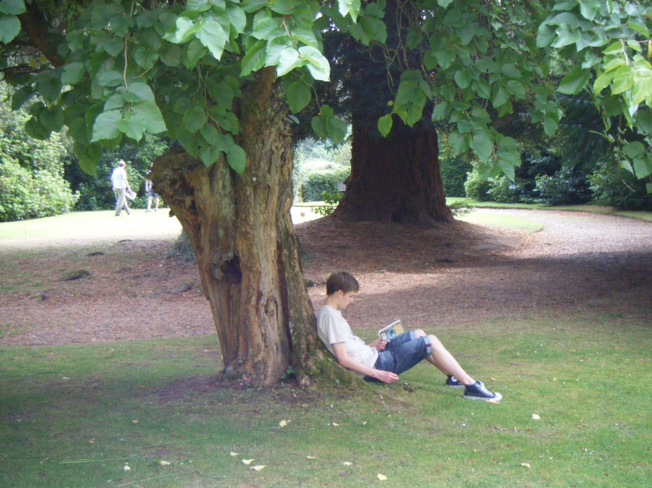
...share the joy of reading

