Slide 1
Las metáforas
Poetry Workshop

Slide 2
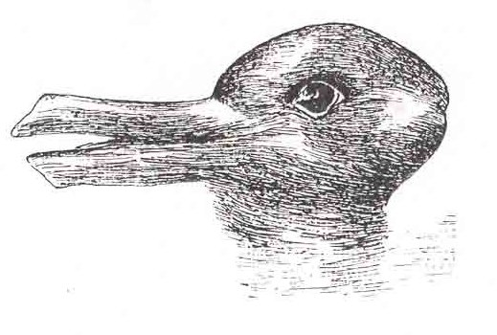
Las percepciones I:
¿Qué veis?
Es un pato…
…o es un conejo?
Notes:
Slides 2 – 4
This is a fun activity about changing perceptions.
Learners may be familiar with these images as they feature in a prominent psychological study.
They can use any previous knowledge to scaffold this task which will make it more light-hearted and fun.

Slide 3
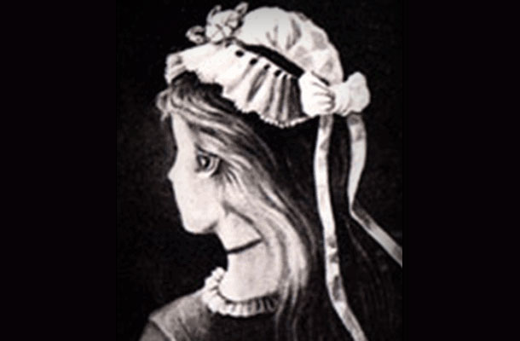
Las percepciones I:
¿Qué veis?
Es una jovén…
…o es una vieja?

Slide 4

Las percepciones I:
¿Qué veis?
Es un burro…
…o es una foca?

Slide 5
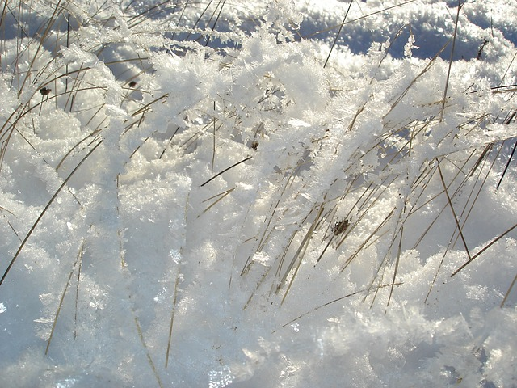
Las percepciones II:
¿Qué es esto?
La puesta de sol
Una cama de clavos
La nieva sobre la hierba
El baile de los muñecos de palitos
El arco iris
Notes:
Slides 5- 7
This activity first asks learners to choose a plain speech description from the left hand side of the image. Learners may work together to do this using any support deemed necessary.
The second part asks them to consider poetic language, i.e. the metaphor. Learners decode and choose the metaphor from the right hand side of the image they think is most effective and say why. Discuss this with the class.

Slide 6
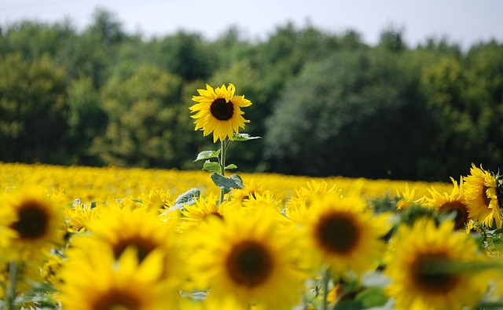
Las percepciones II:
¿Qué es esto?
Un campo de girasoles
Un senor alto bajo el sol
Un jardín de rosas
Un sol encadenado a la tierra
Un erial

Slide 7
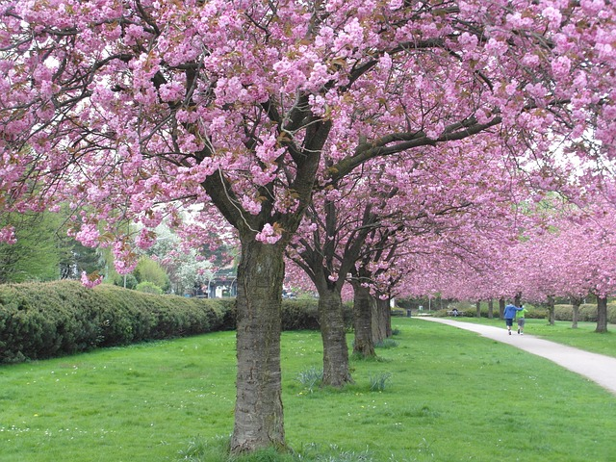
Las percepciones II:
¿Qué es esto?
Un espacio verde
La vida en rosa
Una zona peatonal
Un cielo algodón de azúcar
Los cerezos en flor

Slide 8
Mis sentidos…
Veo…
Oigo…
Huelo…
Toco…
Saboreo…
Notes:
Slides 9 – 12
Before learners compose their own “I am” poems, these slides ask them to work in groups completing the sentences from the perspective of the sunflower. (You may use any other image or object)
Learners may do this activity like a game of “Consequences” where one person writes a line then passes it on to the next person to complete the next line.
After each slide bring the class together and discuss what they have written. What interesting language has been used? What interesting perspectives did they think of?

Slide 9
Mis sentimientos y pensamientos
Pienso en…
Me siento…
Conozco a…
Imagino…

Slide 10
Mis esperanzas y mis temores
Sueño con…
Tengo miedo de…
Espero…

Slide 11
Mis ganas…
Quiero…
Me encanta…
Necesito…

Slide 12
¿ Quién soy-yo?
Soy _______________
Veo_______________
Oigo _________________
Huelo __________________
Toco _______________
Saboreo ___________
Soy _______________
Notes:
Slides 13 – 15
Now bring the class together. Using a selection of sentences from each group compose a whole class “I am” poem based on the perspective of the sunflower (or other object).
You may decide which sentences to use by asking each group to write their responses on flipchart paper, sticking these to the board/wall and asking the class to put a tick next to their favourite sentences.

Slide 13
Who am I?
Imagino _______________
Conozco a_______________
Me siento _________________
Tengo miedo de__________________
Necesito _______________
Soy_______________

Slide 14
Who am I?
Quiero_______________
Pienso en _______________
Sueño con _________________
Me encanta__________________
Espero _______________
Soy _______________

Slide 15
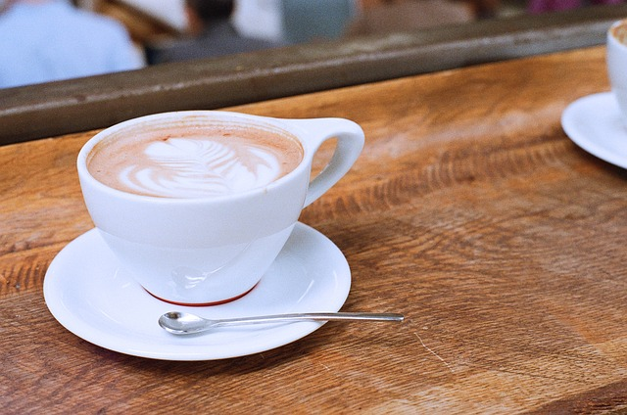
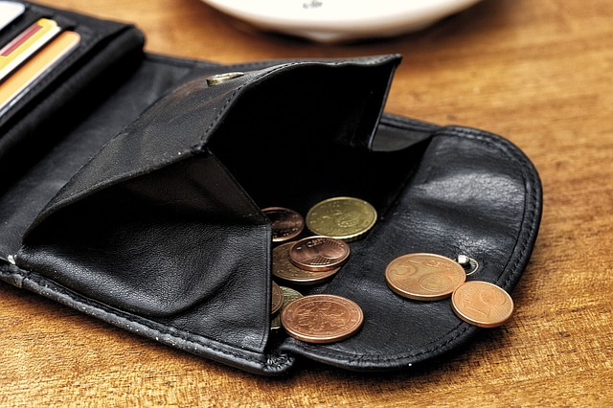
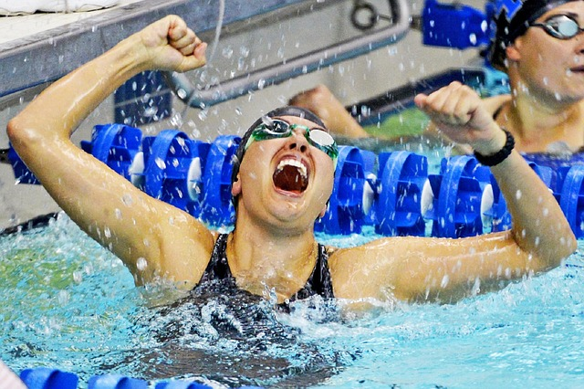

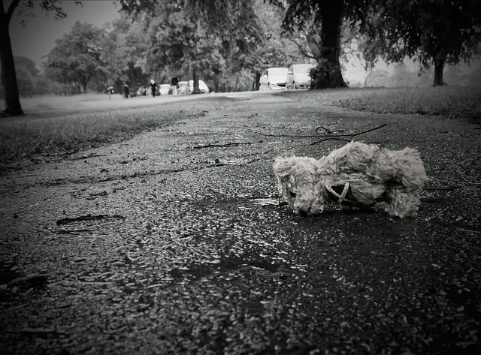
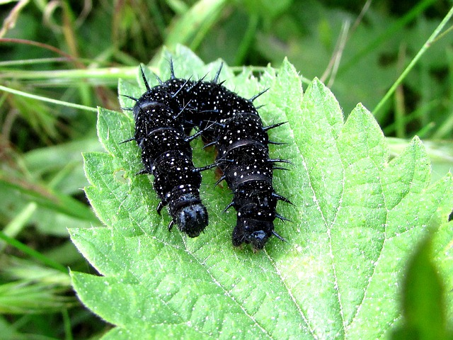
Notes:
Slides 16-17
Using the structure of the “I am” poem in the last slides 13 - 15, learners write their own “I am” poem in the target language.
You may provide images, like these, or a mystery box of objects as inspiration. If studying a text in the target language, learners may write their poems from the perspective of one of the characters. Learners may write their poem from the perspective of a more personal object or person they know.

Slide 16
